Slide 1



Enhanced Report
View in Power BI
Last data refresh:
05/04/2021 12:11:18 India Standard Time
Downloaded at:
05/04/2021 12:14:36 India Standard Time

Slide 2
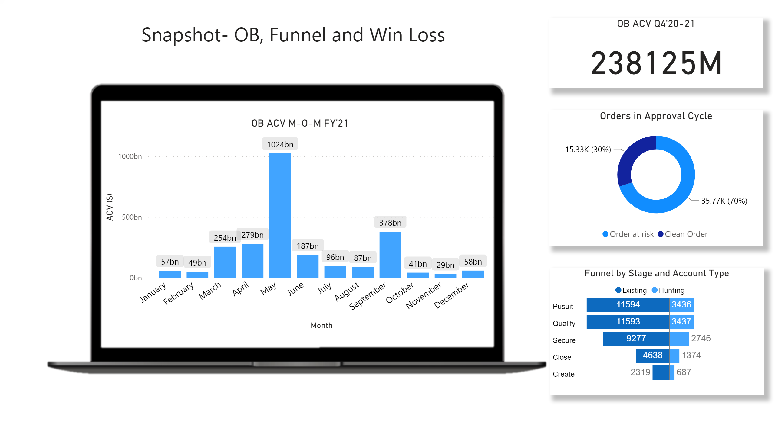
OB,Funnel & Win-Loss
Notes:
OB ACV Q4'20-21
No alt text provided.
Orders in Approval Cycle
No alt text provided.
Funnel by Stage and Account Type
No alt text provided.
OB ACV M-O-M FY'21
No alt text provided.
image
No alt text provided.
textbox
No alt text provided.

Slide 3
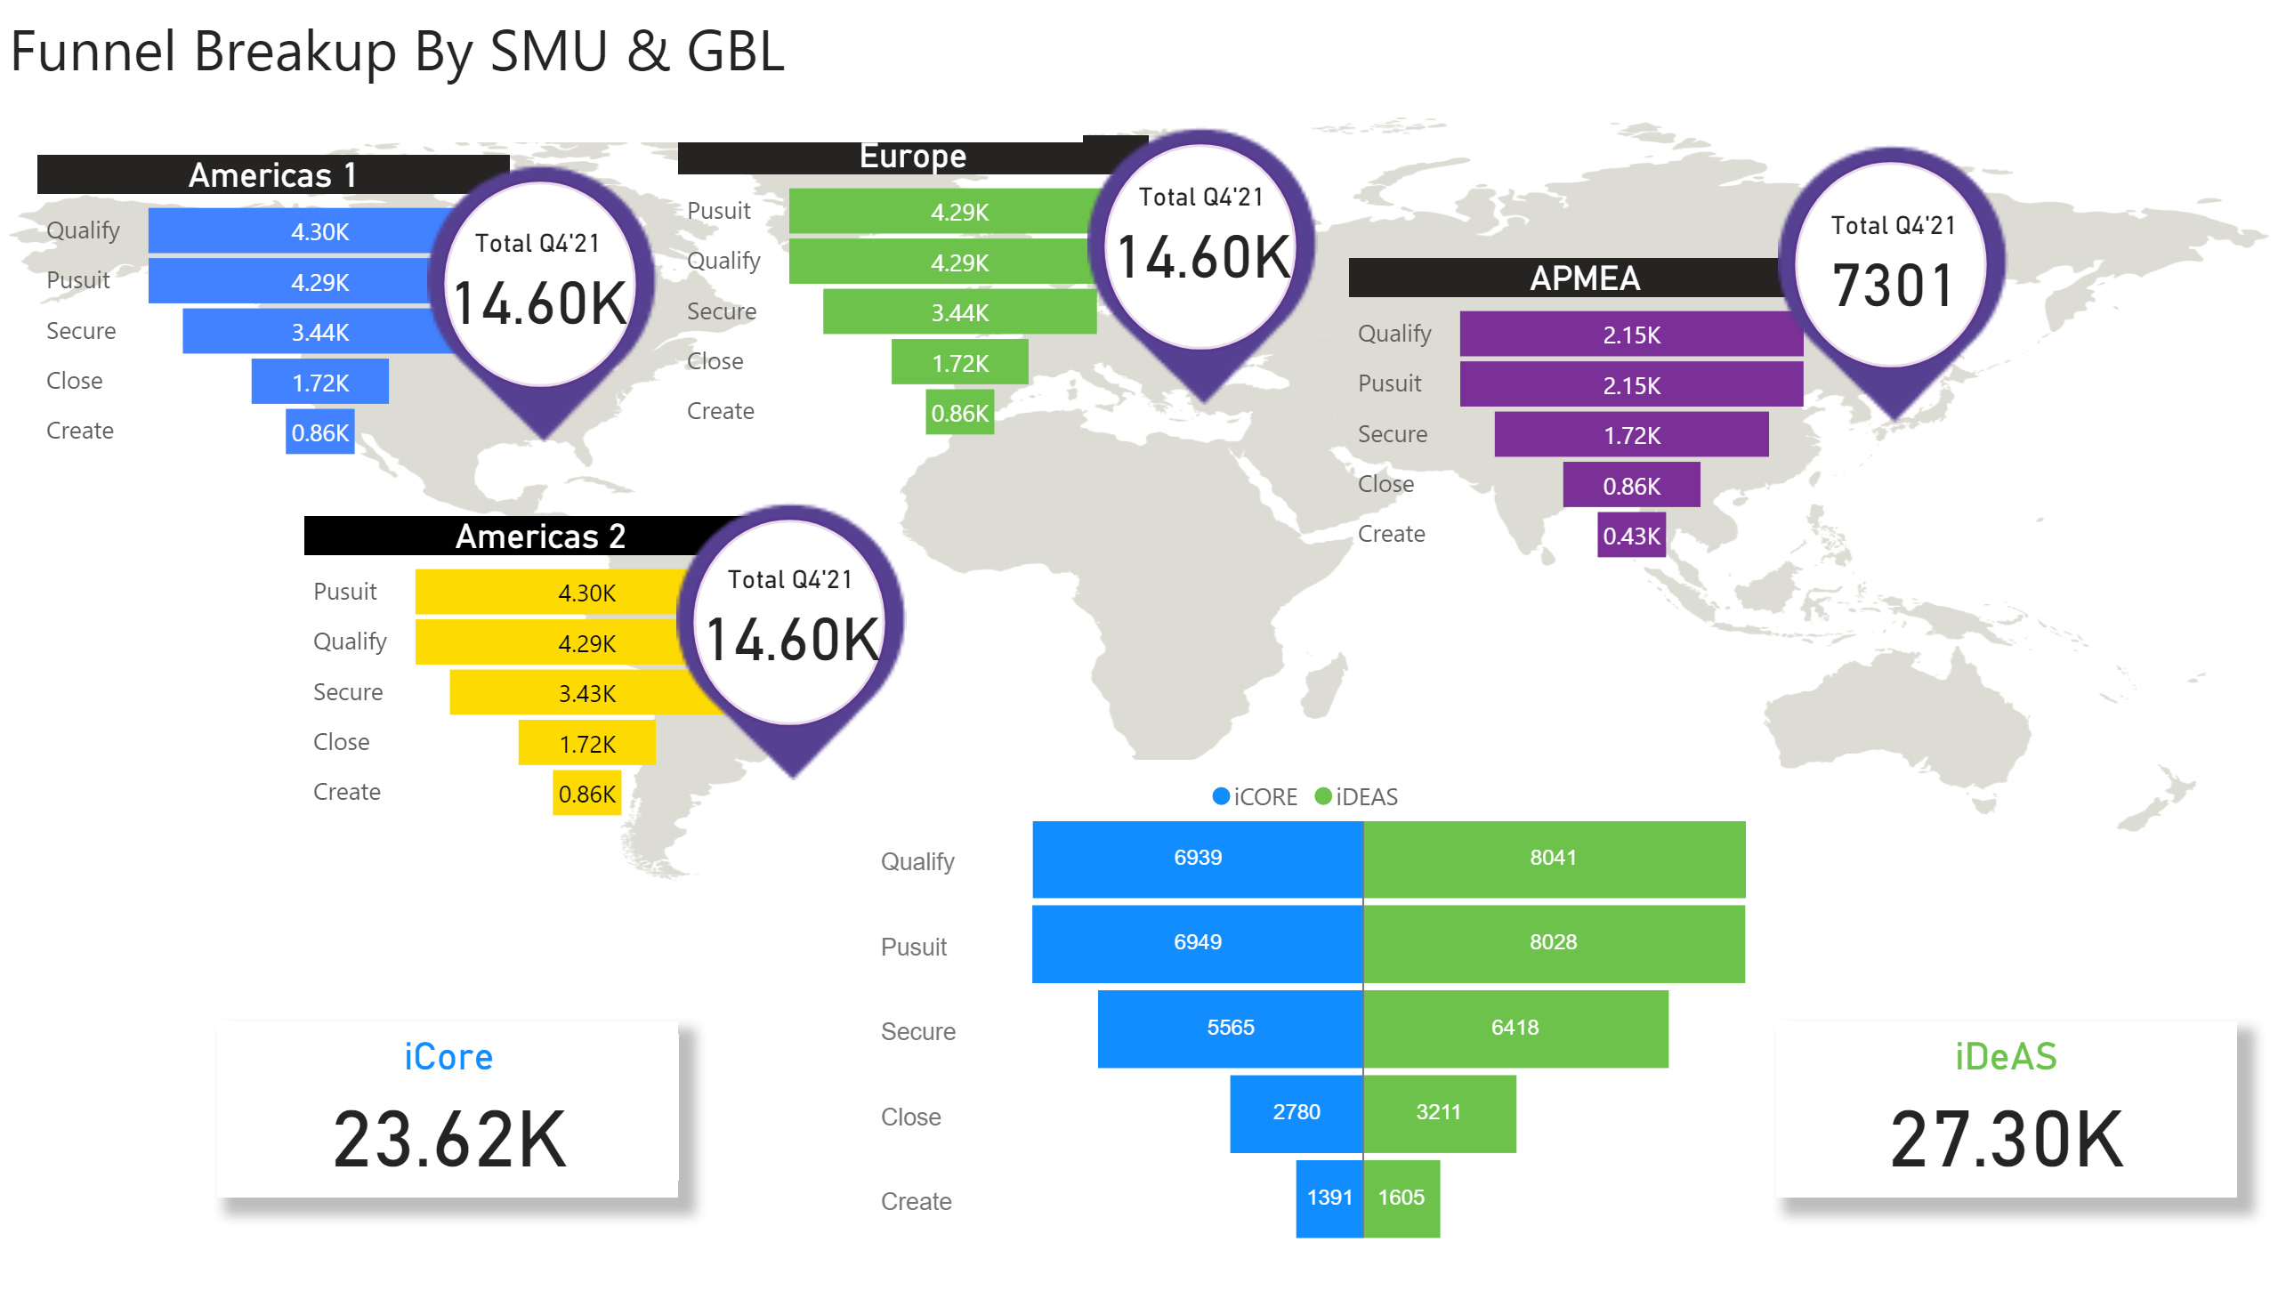
Funnel Breakup by SMU & GBL
Notes:
image
No alt text provided.
Americas 1
No alt text provided.
Americas 2
No alt text provided.
Europe
No alt text provided.
APMEA
No alt text provided.
basicShape
No alt text provided.
image
No alt text provided.
basicShape
No alt text provided.
image
No alt text provided.
basicShape
No alt text provided.
image
No alt text provided.
basicShape
No alt text provided.
image
No alt text provided.
Total Q4'21
No alt text provided.
Total Q4'21
No alt text provided.
Total Q4'21
No alt text provided.
Total Q4'21
No alt text provided.
TornadoChart1452517688218
No alt text provided.
basicShape
No alt text provided.
basicShape
No alt text provided.
iCore
No alt text provided.
iDeAS
No alt text provided.
textbox
No alt text provided.

Slide 4
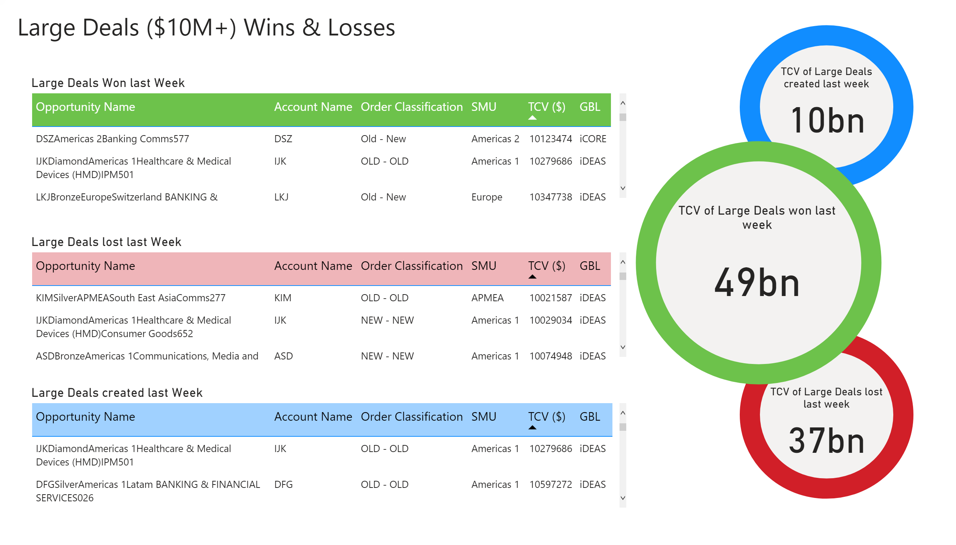
Large Deal1
Notes:
basicShape
No alt text provided.
basicShape
No alt text provided.
basicShape
No alt text provided.
Large Deals lost last Week
No alt text provided.
Large Deals Won last Week
No alt text provided.
Large Deals created last Week
No alt text provided.
textbox
No alt text provided.
TCV of Large Deals created last week
No alt text provided.
TCV of Large Deals won last week
No alt text provided.
TCV of Large Deals lost last week
No alt text provided.

